Slide 1
Financial MATTERS
Presented by BDO Canada LLP

Slide 2
AGENDA
Introduction
Topic 1
Topic 2
Topic 3
Topic 4
Get to know me
Importance of sound financial practices
Key steps in the budget process
How to interpret financial statements
The role and importance of audit

Slide 3

Rene Grewal, cpa
Municipalities auditor
Not-for-profit auditor
Small business auditor
Bookkeeper, accountant, and consultant
Personal, corporate, and charity tax preparer
Manager
Assurance services

Slide 4

What are financial practices?
Definition
Standard operating procedures for carrying out accounting, financial reporting, and budgeting
Purpose
Consistency
Transparency
Accountability
Accuracy
Protection

Slide 5




What are financial practices?
Authorization
Segregation of Duties
Reconciliations
Review of results

Slide 6

What are financial practices - Authorization
What?
    Manager approves invoices over $3,000 for payment
How?
    Signature on invoice or email approval
Why?
    Prevents: invoices from being paid when they shouldn’t
    Detects: errors or discrepancies in invoices before payment

Slide 7
What are financial practices - Reconcile
What?
    Bank reconciliation at month end
How?
    Accounting software, excel, or on paper
    Proof of work performed, and signature of preparer
Why?
    Detects: discrepancies in the financial data

Slide 8
What are financial practices - Review
What?
    Monthly financial statement review at council meetings
How?
    Documented in meeting minutes
Why?
    Detects: discrepancies in the financial data

Slide 9
What are financial practices – Segregation of duties
What?
    Separating the tasks that make up a transaction
How?
    The person who approves an invoice, should not also write the cheque
Why?
    Prevents: errors and discrepancies in the transaction

Slide 10



Key Steps in the Budgeting Process
Types of Budgets
Operating Budget
      Used for everyday revenues and expenses
Capital Budget
      Used for long-term investments and infrastructure
Cash Budget
      Used to account for timing of payments in operating and capital budgets

Slide 11
Key Steps in the Budget Process
Step 1
Step 2
Step 3
Step 4
Step 5
Review the previous period
Estimate revenues
Set out fixed and variable costs
Forecast new spending
Scrutinize cash flows
Ask questions at each step of the process

Slide 12
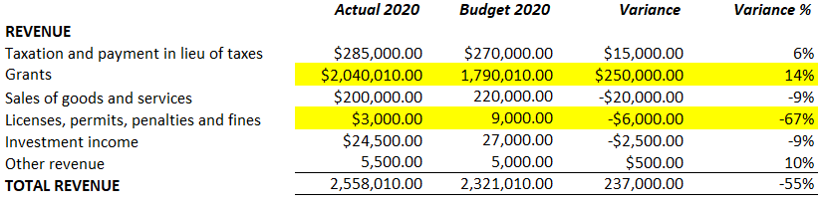
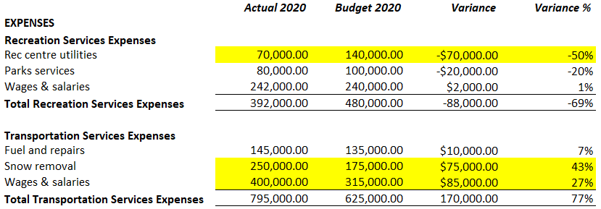
Key Steps in the Budget Process
Step 1: Review the previous period
New COVID grant?
Extension of payment dates?
Closure of services?
Extreme weather events?
Impact on overtime?

Slide 13
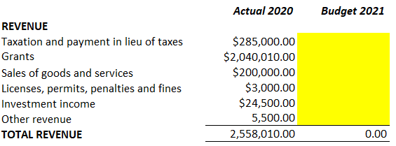
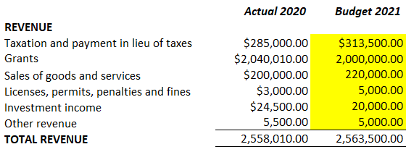
Key Steps in the Budget Process
Step 2: Estimate revenues
Will taxation rates increase? Can a percentage increase be applied?
Have any grants been committed to continue or cease?
Will user fee revenue increase? Can a percentage increase be applied?
Will payment revert to stricter due dates post-COVID?
Are interest rates expected to drop?
Is other revenue expected to be nominal?
Council meetings should discuss these questions prior to the new fiscal year

Slide 14
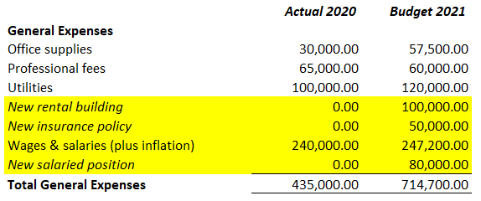
Key Steps in the Budget Process
Step 3: Set out fixed and variable costs
Will there be any new or increased fixed costs?
How will variable costs change?
Are employees receiving a wage increase for inflation?
Will discretionary spending change?

Slide 15
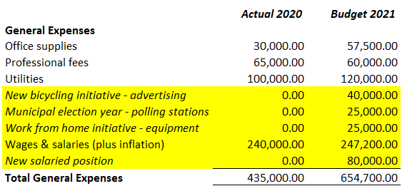
Key Steps in the Budget Process
Step 4: Forecast new spending
Are there new objectives taking place in the upcoming fiscal year?
Are there irregular expenditures coming up?
Are the previous year’s irregular expenditures expected to become regular?
Is there room from the previous year’s surplus to increase spending?
Will capital expenditures need to be added to the capital budget?
These questions will depend on the strategic direction chosen by mayor and council

Slide 16
Key Steps in the Budget Process
Step 5: Scrutinize cash flows
What does the budget look like from a big picture perspective?
Is there a budgeted surplus or deficit?
Are there any indicators that certain parts of the budget should be investigated?
Does the budget appear realistic, for all departments and service lines?

Slide 17
How to Interpret Financial Statements
Audit
Reasonable assurance
Opinion issued
Review
Limited assurance
Conclusion issued
Compilation
No assurance
No opinion or conclusion
Types of Financial Statements
Audit
Review
Compilation

Slide 18
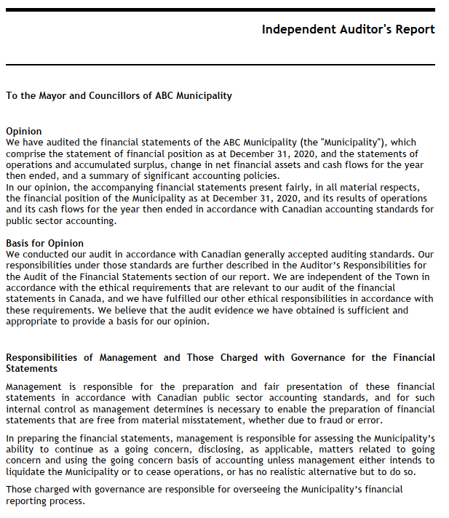
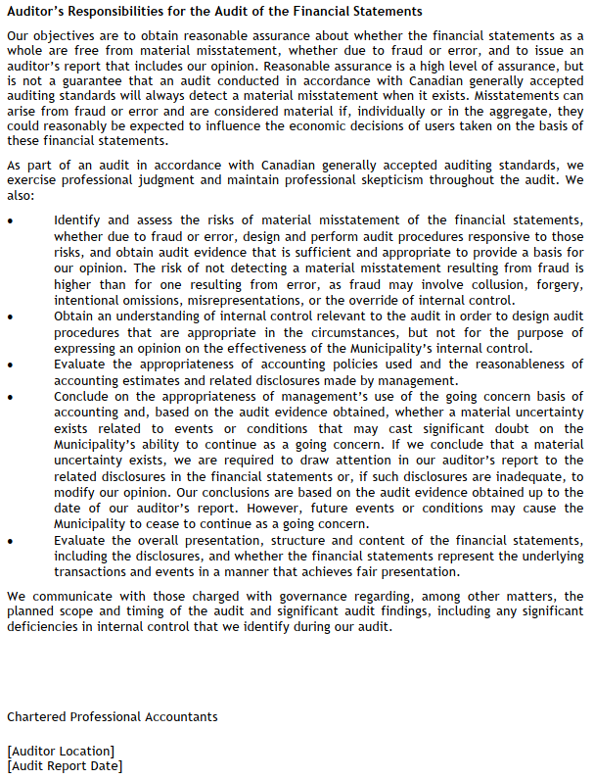

Slide 19
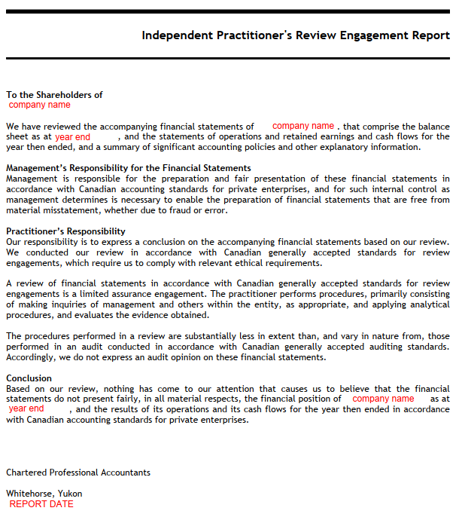
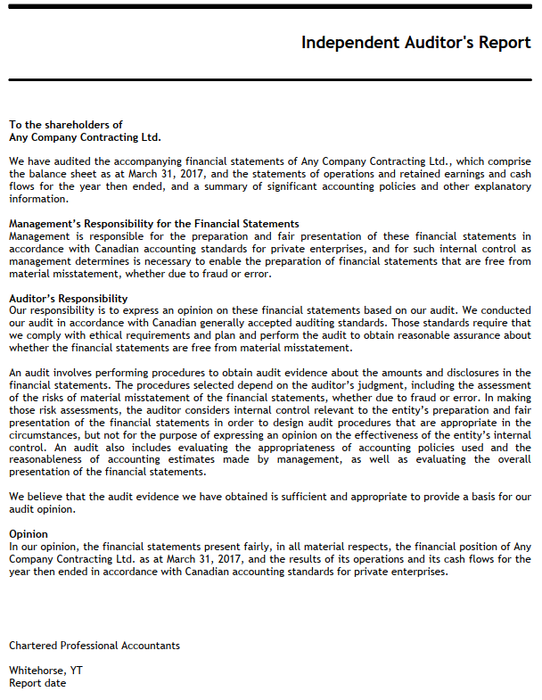

Slide 20
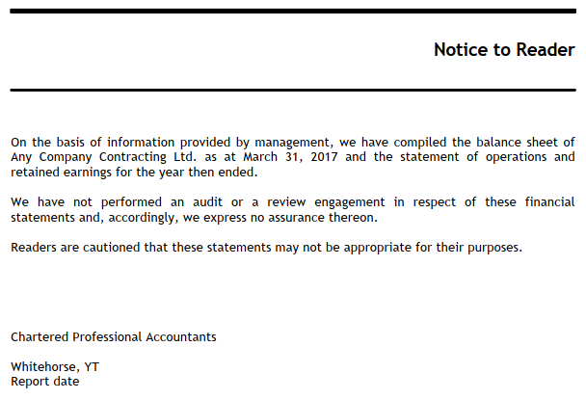

Slide 21
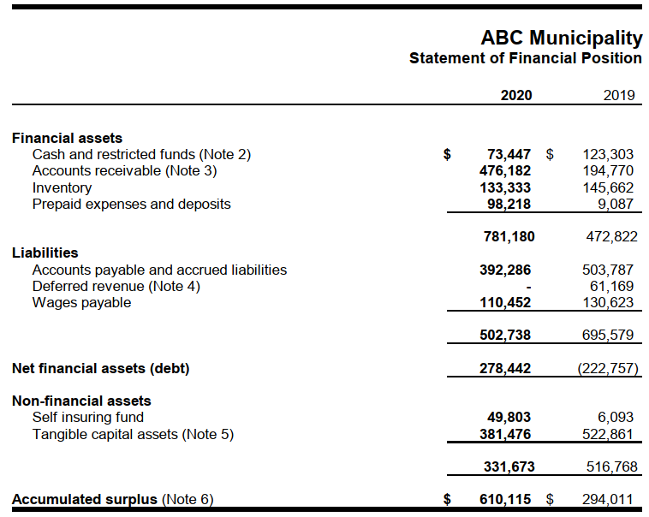
How to Interpret Financial Statements
Statement of Financial Position
Financial Assets: financial assets that the organization controls
  Cash, accounts receivable, inventory held for resale
Non-Financial Assets: assets that will be used up when providing future services to the public
  Self insuring fund, inventory held for use, capital assets
Liabilities: existing financial obligations which will lead to use of financial assets
Surplus: net economic resources from all years of operation to date

Slide 22
How to Interpret Financial Statements
Statement of Financial Position
Is the net financial assets figure increasing?
Is the accumulated surplus increasing?
Has the capital asset expenditure been sufficient?
Are there any “red flags”?
Are there any covenant requirements from the bank or funders?
Does the municipality have sufficient working capital?

Slide 23
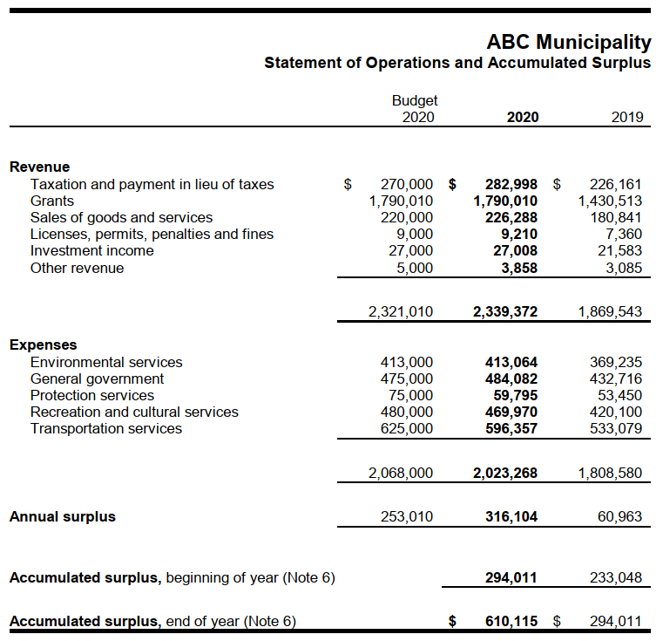
How to Interpret Financial Statements
Statement of Operations and Accumulated Surplus
Annual Surplus: presents whether the revenues earned in the year were sufficient to cover the expenses
Important to review:
  Trends of annual surplus
  How dependent the organization is on grant and transfer revenue
Budget to Actual Results: presents how well the budgeted plan was executed during the year
For a breakdown of each expense line item, a financial statement note is prepared

Slide 24
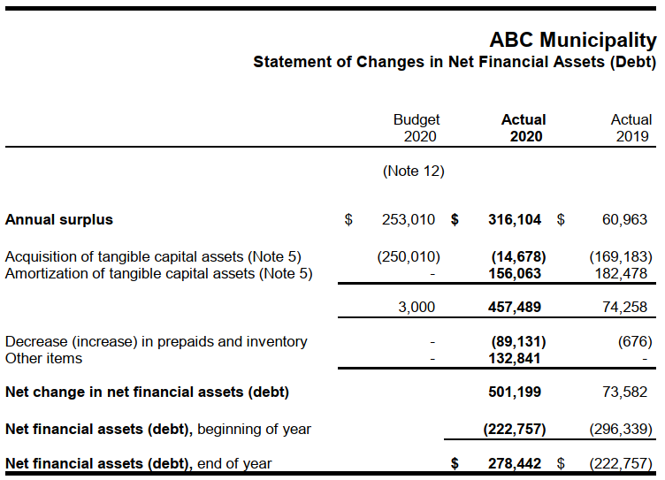
How to Interpret Financial Statements
Statement of Changes in Net Financial Assets
Separates the change in total annual surplus from the change in net financial assets
Identifies capital asset purchases

Slide 25
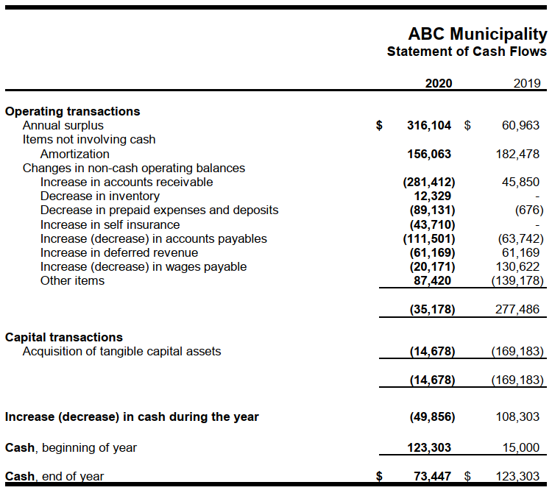
How to Interpret Financial Statements
Statement of Cash Flows
  Provides detailed information on cash transactions that are not included in the Statement of Operations
  Identifies where cash was actually spent/received, which differs from accounting standards for net income

Slide 26
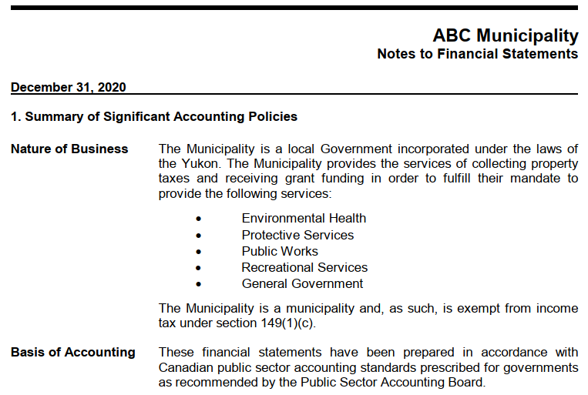
How to Interpret Financial Statements
Notes to Financial Statements
  Notes provide written detail over the figures in the financial statements
  Typically will describe details for:
    Basis of accounting
    Related parties
    Capital assets
    Budget
    Unusual events/activities
    Segment information

Slide 27

Role and Importance of Audit
What is an audit?
    An examination of financial statements to ensure:
        Accurate and fair presentation in all material respects
        Compliance with relevant accounting standards

Slide 28

Role and Importance of Audit
Existence
Occurrence
Completeness
Accuracy
Valuation
Rights and obligations
Cut-off
Classification
What does the auditor do?
    Gain an understanding of the organization
    Prepare risk assessment
    Prepare an audit plan to address the risks
    Perform audit testing to gain assurance
    Report on audit findings
    Identify potential efficiency points

Slide 29
Role and Importance of Audit
Oversight
    Auditor will perform testing over all financial statement areas to ensure accuracy of the underlying financial data
    Any variances found during the testing are investigated further
Credibility
    Audit firms are qualified by the CPA institute, not just any CPA can perform an audit
    CPA requires the auditor to be independent, objective, and competent to their standards
Incidental results
    Auditors may detect errors or fraud during the testing phase of the audit
    Auditors can use their in-depth knowledge of the organization to provide advice and assistance

Slide 30


Conclusion
Financial Practices
    Important in enhancing accountability and accuracy
Budgeting
    Five key steps to creating a realistic and achievable budget
Financial Statements
    Four main statements, and essential financial statement notes
Audit
    Increases oversight and credibility, and creates opportunity for future assistance

Slide 31

Any Questions?

